Slide 1
Lecture 7: BA at the Data Source Level
Prof. Mike Boyle
Department of Operations and Information Systems
University of Utah

Slide 2
Lecture Outline
Terminology
Examples of Data Sources
Prioritizing Data Sources
(Storing data) Designing Data Model for Usability
Combining Data From Data Sources
Data Quality
Big Data and Data Sources
Framework for Prioritizing Data Sources

Slide 3
Terminology
Primary data: collected for a specific analytical purpose
E.g. customer questionnaire data to analyze a particular part of the business process
Secondary data: collected as part of a process, and also available for analytical purposes
E.g. data from order management system

Slide 4
Examples of Data Sources: Systems Perspective
Internal sources:
Order Management System (OMS)
Customer Relationship Management (CRM) system
Inventory management system
Warehouse management system
Calendar/scheduling system
External sources:
Twitter
Web/Digital Analytics system
Keyword Management system
Customer Survey system

Slide 5
Examples of Data Sources: Data Perspective
Internal sources:
(data from all systems on previous slide)
Employee survey data
External sources:
(data from all systems on previous slide)
Customer demographic data (e.g. Axciom)
Business data (e.g. Dunn and Bradstreet)
Web/Mobile/Digital asset behavior data (e.g. Compete.com/Experian Hitwise)
Market research data

Slide 6
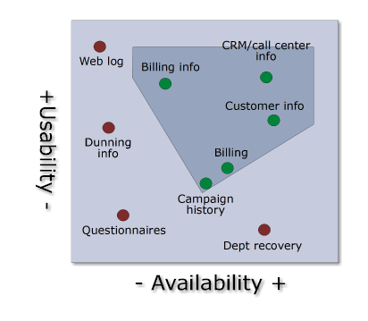
Prioritizing Data Sources
When prioritizing which data source(s) to include in the DW consider:
Availability (I.e. is data “easy” to acquire?)
Usability (I.e. once data is acquired, is it “easy” to work with?)

Slide 7
Prioritizing Data Sources (cont’d)
What would make data more or less easy to work with from the following perspectives:
Availability
IT System Access
Is there access to the data at all in any system?
E.g. often analysts are allowed to access data but need IT to provide them with credentials
Suitable Analysis Environment Availability
Is the data in an environment where it can be analyzed?
E.g. users typically are not allowed to run analysis queries on production environment
Security Requirements
Do all/some/no analysts have security clearance to analyze the data?
Based on security requirements, can data be transferred to an analysis environment?
Data Volume
Can the data be transferred to an environment where it can be analyzed?
E.g. some data is too large to transfer practically to analysis environment

Slide 8
Prioritizing Data Sources (cont’d)
What would make data more or less easy to work with from the following perspectives:
Usability
Standard data format and values – allows relatively simple logic and queries to be applied when processing
Disaggregated – supports many potential aggregations (e.g. by week or by month); if already aggregated by month, cannot break down by week
Note: Some aggregations can be created as a convenience to support common reporting/analysis tasks
Processed to derive relevant fields for analysis – E.g. the date, “2013-10-15” can have the following derived analysis fields: day_of_week = “Tuesday”, month_of_year = “October”, week_in_month = 3, etc.

Slide 9
Prioritizing Data Sources (cont’d)
For each Data Source what are the potential:
Insights?
E.g. External: Market Research Data >> Identify new markets that a business might enter with a new or existing product
E.g. Internal: Employee Survey Data >> A higher than expected level of attrition is likely to occur within the call center
Actions?
E.g. External: Social Data (e.g. Twitter) >> Respond transparently, rapidly and cost-effectively to a product issue that customers are negatively tweeting about
E.g. Internal: Inventory Management System >> Based on an alert which fires when the inventory level for a given product is too low, an automatic replenishment order is placed with the supplier

Slide 10
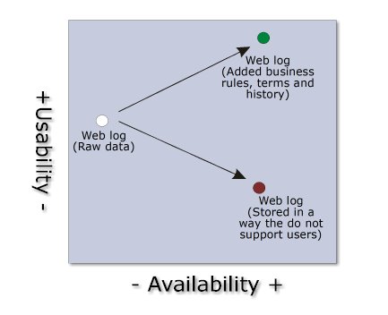
(Storing Data) Designing Data Model for Usability
When adding a new Data Source to the Data Warehouse it can be designed to be more or less usable
Recall from the Modern DW Architecture: data in the Exploratory Area are relatively less usable as compared to the Traditional Area

Slide 11
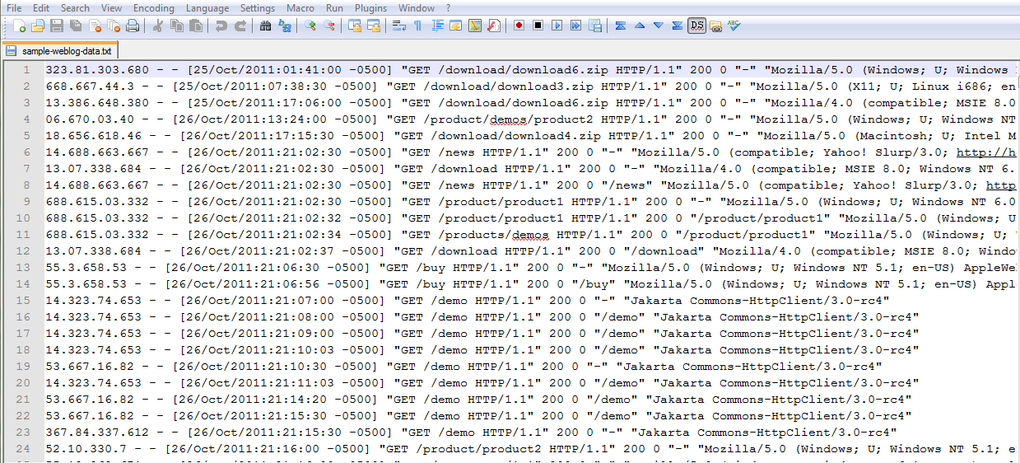
Sample Weblog Data

Slide 12
(Storing Data) Designing Data Model for Usability (cont’d)
What would make the web log data more usable?
It is already:
In a “standard data format”
“Disaggregated”
Needs to be:
“Processed to derive relevant fields for analysis”
Can also add:
Data quality checks to make sure, for example:
There are no missing time periods in the data
Bot traffic can bet identified and separated from real user
Some practical aggregations can be created to support common reporting/analysis tasks
E.g. Can aggregate individual users’ page requests over periods of time into “Visits”
E.g. Can aggregate by hour of the day because that’s how the business is monitored and/or analyzed

Slide 13
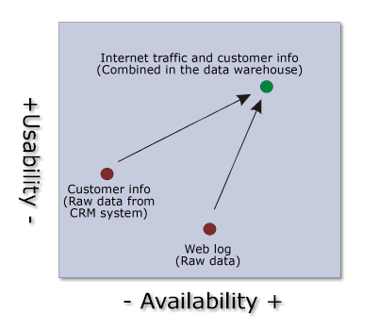
Combining Data From Data Sources
Note the usability and availability of each Data Source
Note the usability and availability of the integrated customer and web behavior data

Slide 14
Combining Data From Data Sources (cont’d)
What other combinations of Data Sources might be considered?
E.g. Web Log Data + Customer (CRM) Data
Insight: Customers who spend a medium amount of time on the site (i.e. not a small amount and not a large amount) are the highest lifetime value customers
Action: Target these “medium” customers; reduce targeting of customers in other two groups.
E.g. Call Center Phone Data + Web Log Data
Insight: By geography, there are different distributions of customers using the Call Center vs. the Web
Action: Through various campaigns, raise awareness to geographies where there is relatively low web usage (assuming web is the most efficient channel)

Slide 15
Data Quality
Concepts:
A minimum level of data quality is required in order for analytics projects to be successful
The higher the level of data quality, the more likely analytics projects will be successful
However…
The cost of having perfect data may be higher than the value generated therefrom
The time elapsed while waiting for perfect data (i.e. not making decisions) may be detrimental to the business

Slide 16
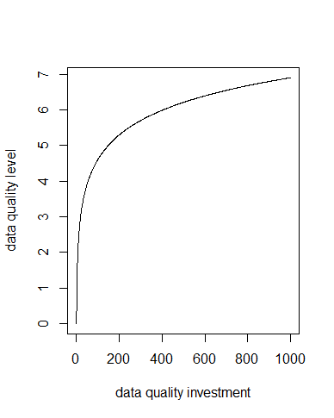
Data Quality (cont’d)
There are diminishing returns to investments in data quality
i.e.
Initial investments have high return
Subsequent investments have lower return

Slide 17
Data Quality (cont’d)
What are some ways to improve data quality in an organization?
Concept: Fix data issues as close to the source as possible:
Free-form text input validation (e.g. must enter numeric value)
Structure user input where possible (e.g. use a drop-down list instead of a free-form text field)
In the source system, use most restrictive possible data type in the database (e.g. for a field that always contains two-letter state abbreviations, use a char(2) instead of a varchar(50))
For issues, not addressed in the source system:
Fix them in the ETL process of the Data Warehouse
AND THEN MAKE SURE TO
Monitor and regularly report on these data quality issues to raise awareness
The objective in raising awareness to eventually fix these issues at their sources

Slide 18
Big Data and Data Sources
Opportunity: New data types and sources being captured and mined (often rapidly) to create competitive advantages
Unstructured/semi-structured
Links/networks
Images/Videos
Sensor/Geolocation data
Social streams
Hadoop-based (i.e. Big Data) systems can handle the new data types efficiently

Slide 19
Big Data and Data Sources (cont’d)
Internal sources:
Data are relatively more structured and have relatively few sources (i.e. low variety):
Internally supported systems
E.g. eCommerce Website, CRM, custom application, etc.
Unstructured/semi-structured data available
E.g. company email, text from wikis, images, sensors, devices, etc.
Relatively low volume of data
Velocity of data creation and movement relatively low
External sources:
Data are relatively less structured and there are relatively many sources (i.e. high variety)
Text from public websites, social streams, images, sensors, devices, APIs, feeds
Structured data available
Partners’ systems
E.g. Web Analytics data from Adobe Analytics
Purchased data
Relatively high volume of data
Velocity of data creation and movement relatively high

Slide 20
Big Data and Data Sources (cont’d)
Traditional DW technologies…
Big Data technologies…
…designed to manage the level of complexity involved with the majority of the internal data sources
…designed to manage the complexity involved with many of the external data sources
…also work well with internal data sources

Slide 21
Framework for Prioritizing Data Sources
Data Source | Value of Insights (1 – 5) | Value of Actions (1 – 5) | Current Availability ( 1 – 5) | Current Usability (1 – 5) | Current Data Quality (1 – 5) | Additive Effect on Other Data Sources (1 – 5) | Effort to make Available/Usable/Quality (1 – 5) | Additional Context
DS A
DS B
DS C

Slide 22
Appendix

